Slide 1




RL-Enhanced Stochastic State Estimation Framework with EKF-PID Control for Efficient Mapping in
Low-Cost Swarm Robotic Systems
Vishal Roy
12022002011065
Co-Guide: Prof.(Dr.) Deepro Sen
Under the Guidance of :
Dr. R.K. Jain, Sr. Principal Scientist
Intelligent System Engineering Group, CSIR-CMERI
Department of Electrical Engineering
Institute of Engineering & Management, Kolkata
Maulana Abul Kalam Azad University of Technology, West Bengal
2026

Slide 2
Contents:
Problem Statement
Limitations
Introduction
Proposed Framework
IMU Calibration and Orientation Estimation
RL-EKF Integrated Mapping Architecture
Results
Conclusion

Slide 3
Low-cost swarm robotic systems face significant challenges in achieving accurate localisation and efficient environmental mapping due to high sensor noise and bias (motion and Time-of-Flight sensors), actuator drift, nonlinear dynamics, and limited computational resources. Despite extensive research, there remains a lack of robust, real-world deployable solutions, with most existing approaches either relying on expensive hardware or being validated only in simulation environments.
1.
Problem Statement:
Comparison of the Existing Swarm Robotic Platforms
Platform | Size (cm) | Sensors | Communication | Software Support
Kilobot | 3.3 × 3.3 × 5.5 | Ambient light, IR proximity | IR-based local | Kilombo simulator, C APIs
e-puck | 7.4 × 7.4 × 4.5 | IR, accelerometer, camera, mic | Bluetooth, IR | Webots, MATLAB, C/C++
GRITSBot | 3.1 × 3.0 × 3.0 | IMU, IR, encoders | Wi-Fi (server-based) | Robotarium cloud
Thymio II | 11.2 × 11.7 × 5.2 | IR, accelerometer, mic, temp | USB, Bluetooth | ASEBA, Blockly, VPL
Mona | 8.0 × 8.0 × 4.2 | Light, temp, IR, sound | Custom (wired/wireless) | ROS + APIs

Slide 4
Limitations in Existing Systems:
Existing swarm platforms are often high-cost or rely on expensive sensors (LiDAR, cameras)
Limited focus on low-cost real-world deployment
Most approaches are validated only in simulation environments
Estimation, control, and learning are treated as separate modules (no unified framework)
Limitations of Traditional estimation methods (e.g., EKF):
2.
Limitations:
Assume Gaussian noise (often violated in real-world scenarios)
Can get trapped in local information maxima.
As a result, existing systems fail to produce robust, accurate, and globally consistent maps in resource-constrained swarm robotics applications, as current platforms are either costly or do not meet the specific requirements, highlighting the need for a customised low-cost solution.
• Lack adaptability to dynamic and non-Gaussian uncertainty

Slide 5
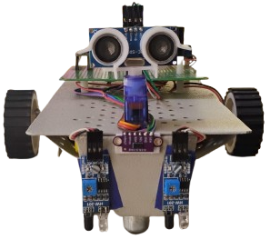
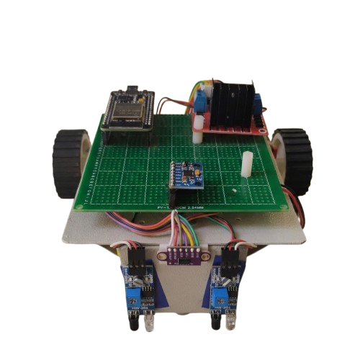
3. Introduction:
Hi, We are StochBots 🤖 We estimate, control, navigate, and map our environments accurately. Together, we form a fully functional scalable and intelligent swarm system for low-cost environmental mapping.
Coordinator Unit
⚙️ What We Can Do
We achieve stable control using PID-based correction
We enable precise navigation (straight motion, turns, distance control)
We perform real-time sensing and mapping using IMU and ToF sensors
We perform state estimation using EKF
We adapt to uncertainty using reinforcement learning
Follower Unit

Slide 6
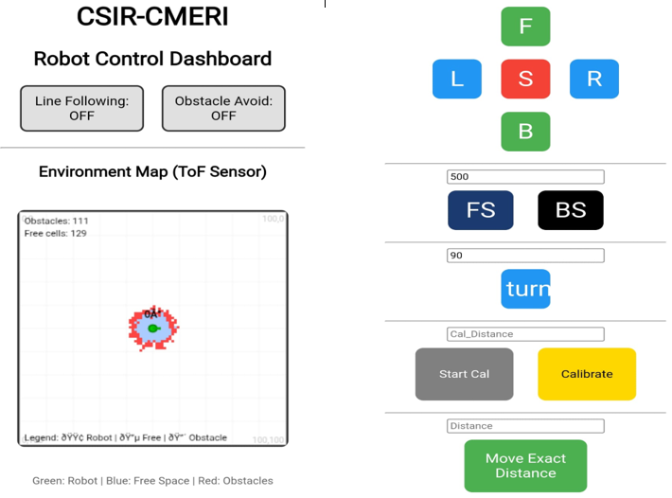
Features
Web Control interface
Straight Line Motion (Yaw Stabilisation): Maintains stable forward motion by minimising angular deviation using IMU-based yaw estimation. A PID controller continuously corrects drift.
Precise Degree Turns (Rotational Control): Achieves accurate angular rotation using gyroscope feedback and Kalman filtering for smooth, drift-free turning.
Fixed Distance Travel (Odometry): Controls displacement using odometry and PID regulation, with ToF feedback to reduce cumulative distance error.
Line Following: Uses dual IR sensors to track a predefined path with real-time motor adjustments for stable trajectory control.
Obstacle Avoidance: Detects obstacles using ultrasonic sensing and performs directional scanning to choose the safest path.
Localised Mapping: Generates an occupancy grid map using ToF sensor data and sensor fusion for accurate environmental representation.
This interface is implemented as an Access Point (AP) mode web handler, hosted directly on the robot at 192.168.4.1. The robot creates its own Wi-Fi network, allowing seamless connection without external infrastructure.
SSID: StochBot
Password: 12345678
Once connected, users can access the dashboard via a browser to perform real-time control, monitoring, and mapping.

Slide 7
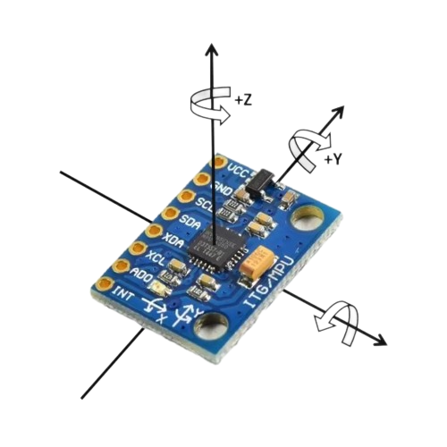
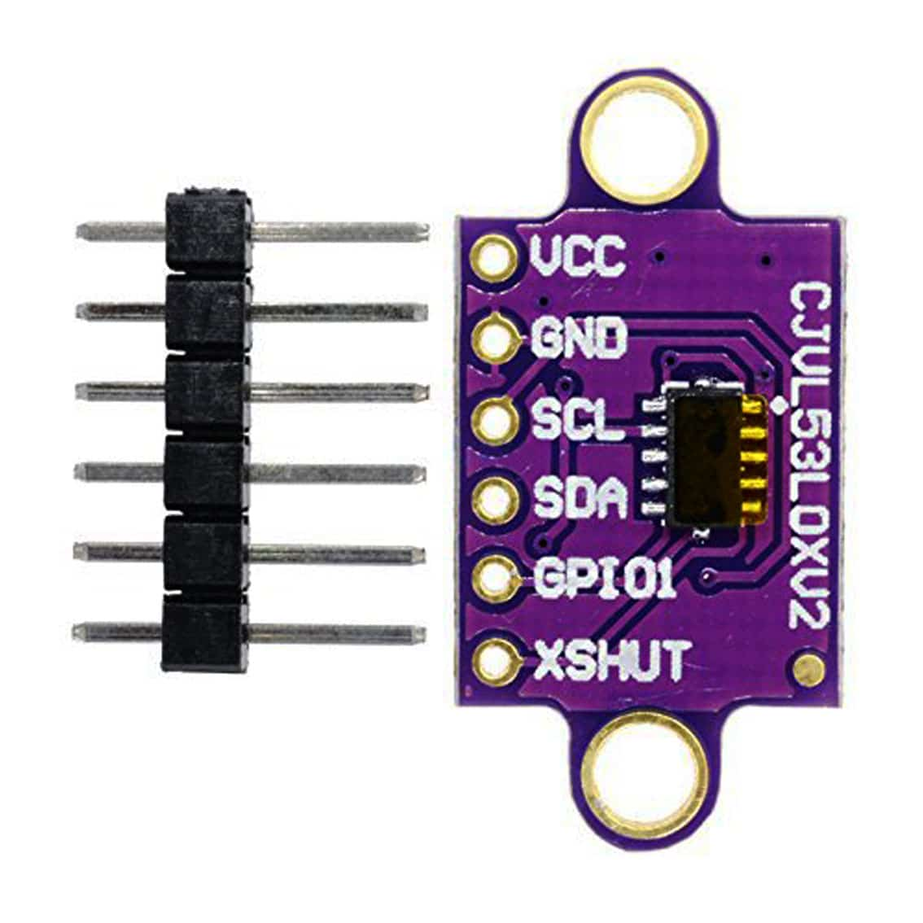
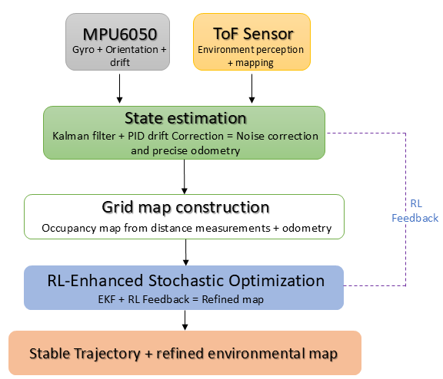
4. Proposed Framework
Sensor Inputs
MPU6050: Orientation & motion (with drift)
ToF Sensor: Distance for environment perception
State Estimation
Sensor fusion using Kalman Filter
Noise reduction & drift correction
Accurate position & orientation estimation
Grid Map Construction
Occupancy grid from ToF + odometry
Represents obstacles & free space
RL-Enhanced Optimisation
Adaptive tuning of EKF (Q & R)
Handles dynamic noise & uncertainty
Avoids local maxima
Final Output
Stable trajectory control
Accurate & refined mapping
The novelty lies in integrating RL with EKF to adaptively tune uncertainty in real-time, which improves robustness and mapping accuracy in low-cost systems.

Slide 8


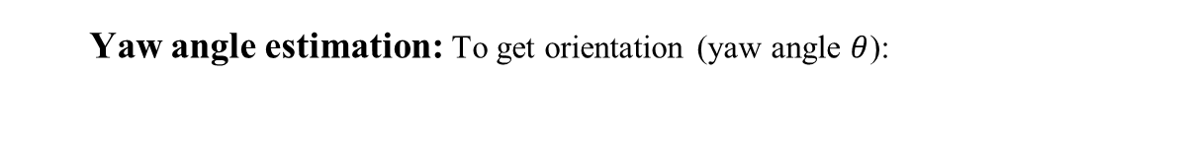
5. IMU Calibration and Orientation Estimation
Static Bias Calibration
Noise reduction using a Kalman filter
Axis | Gyro Bias | Gyro Variance | Acc Bias | Acc Variance
X | 103.2 | 4600 | 528 | 12000
Y | 185.3 | 1800 | -1406.2 | 40000
Z | -50.7 | 400 | 13341.4 | 60000
Yaw angle estimation: To get orientation (yaw angle $θ$):
$$θ=\int{ω_{z}dt}$$
Where,
$ω_{z}:$ is the kalman filter angular velocity about the z-axis

Slide 9
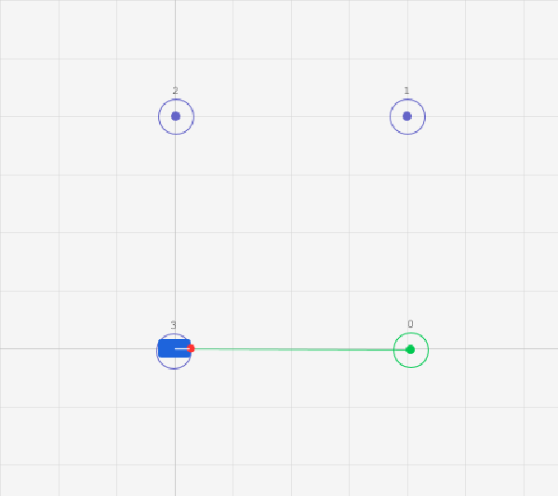
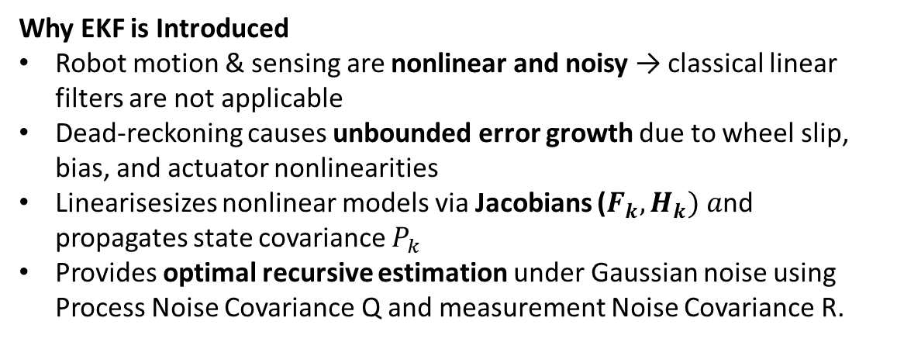
Dead-Reckoning Drift Analysis
EKF-Based State Estimation
Why EKF is Introduced
Robot motion & sensing are nonlinear and noisy → classical linear filters are not applicable
Dead-reckoning causes unbounded error growth due to wheel slip, bias, and actuator nonlinearities
Linearisesizes nonlinear models via Jacobians ($F_{k},H_{k}) a$nd propagates state covariance $P_{k}$
Provides optimal recursive estimation under Gaussian noise using Process Noise Covariance Q and measurement Noise Covariance R.
Robot executed a square trajectory; expected to return to origin (0,0)
Final position error: (0.48 m, 0.12 m) → closure error ≈ 0.495 m
Orientation drift observed: ~11° heading deviation
Highlights limitation of open-loop odometry → need for EKF-based state estimation

Slide 10
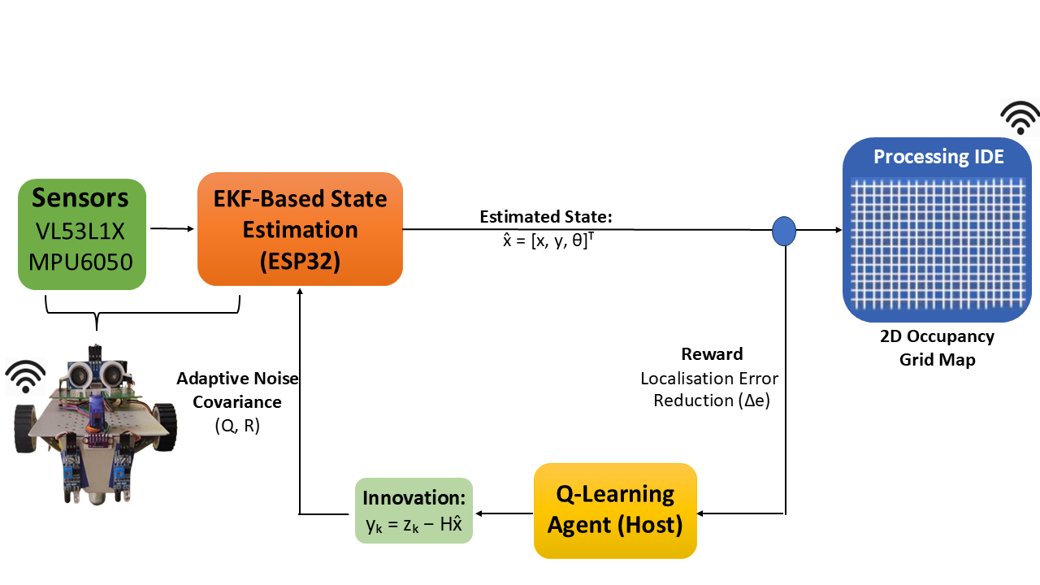
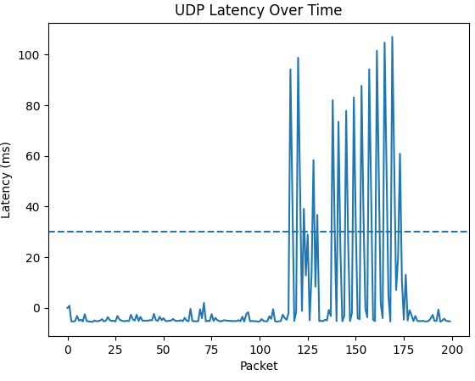
6. RL-EKF Integrated Mapping Architecture
UDP Latency Test
State defined as $X_{t}={\left[x , y , θ\right]}^{T}$→ estimates robot pose within a probabilistic SLAM framework
State defined as 𝑋_𝑡=[𝑥ⓜ,𝑦ⓜ,𝜃]^𝑇→ estimates robot pose within a probabilistic SLAM framework
EKF fuses IMU + ToF + odometry, reducing noise via recursive prediction–correction where Q checks for errors like wheel slip, actuator noise, unmodeled dynamics and R Captures noise from IMU drift, ToF inaccuracies, sensor bias
EKF provides smoother, bounded, and stable estimates, significantly improving trajectory accuracy over raw sensors
Processing & Visualization
Python-based RL module on host PC
Real-time 2D occupancy grid visualization using Processing
Communication & Performance
Sensor data + EKF states streamed via UDP @ 50 Hz
Host PC processes data using Python, which sends adaptive feedback of Q, R for system optimisation.
~5.28 ms latency over 1000 cycles → meets real-time constraints
Packet Loss: 0.00%, low packet loss ensuring reliable transmission

Slide 11
RL Training and Convergence Analysis
Comparative Error Analysis
Episode Range | RMSE (m)
0–20 | 0.038
20–50 | 0.03
50–100 | 0.025
100+ | 0.022
Method | RMSE (m) | Accuracy
Raw Sensor Data | 0.063985 | Baseline (0%)
EKF | 0.036989 | ~42% improvement
RL + EKF | ~0.022 | ~65–70% improvement

Slide 12
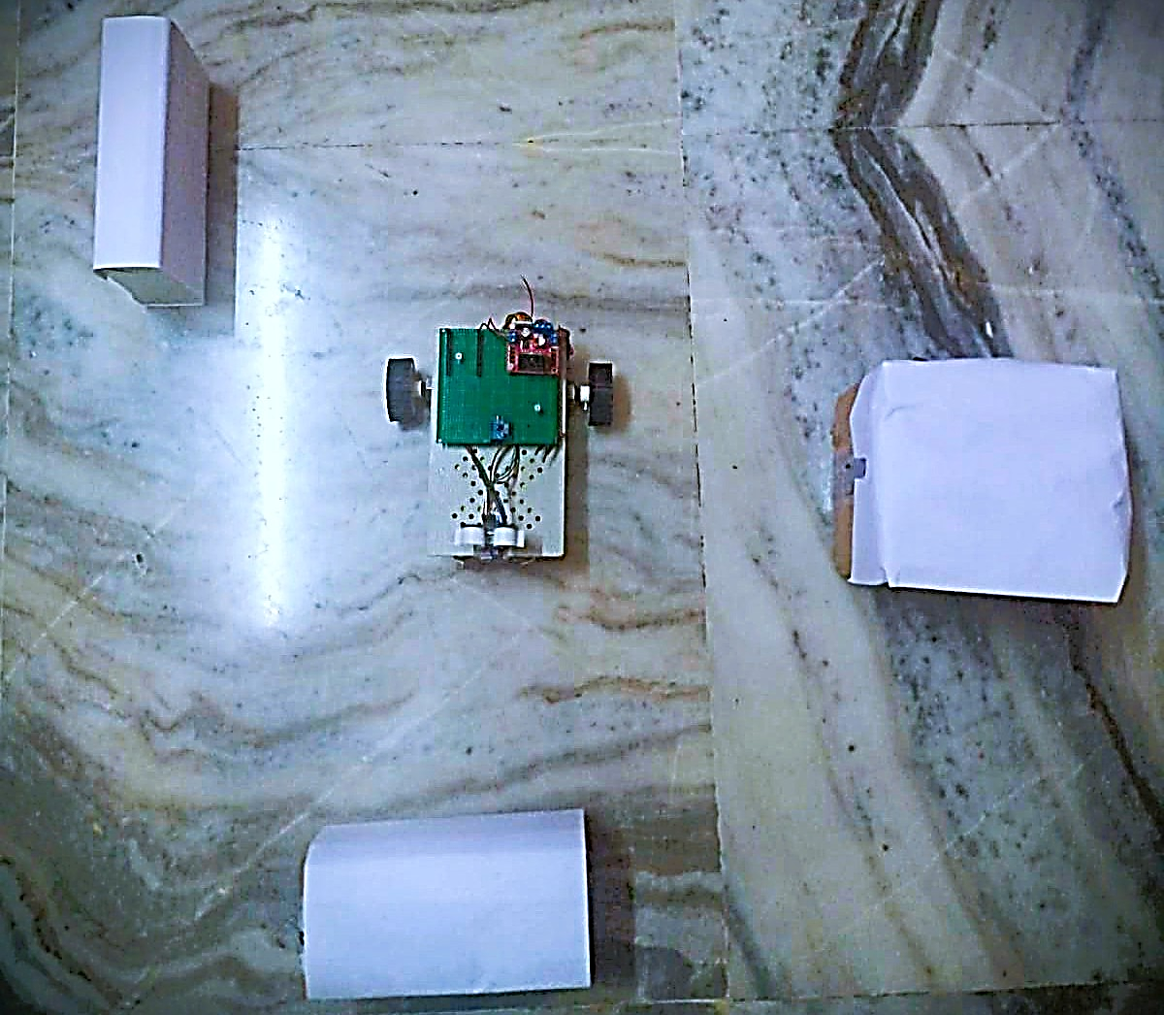
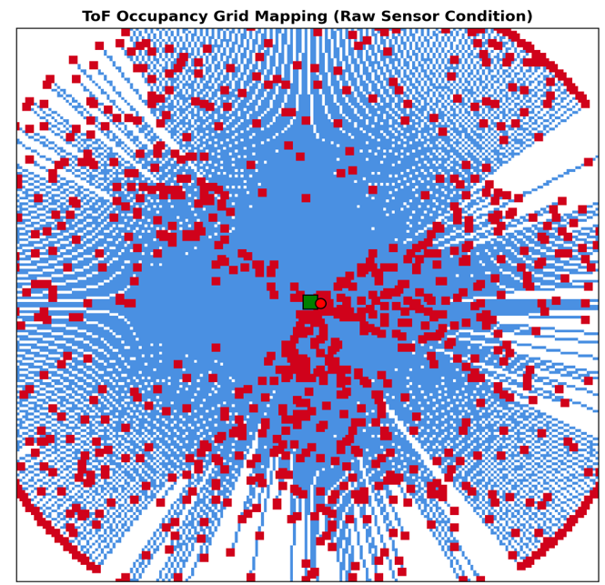
7. Results: Real-World Setup & Raw Mapping
OBSERVATION
Raw ToF: Noisy occupancy grid
False detections: High false positives & fragmented boundaries
Necessitates EKF-based state estimation
Experimental Setup: ToF-based mobile robot in a structured indoor environment.
Raw Sensor Mapping: High noise, scattered detections, and poor spatial consistency.

Slide 13
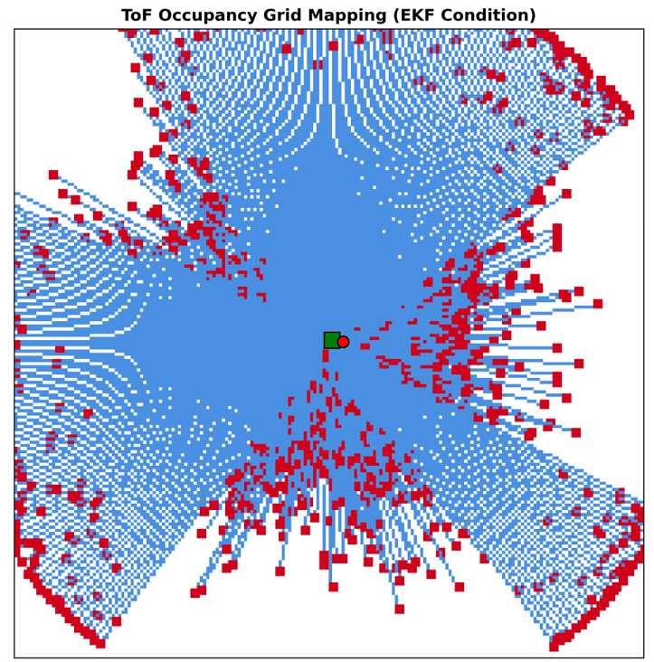
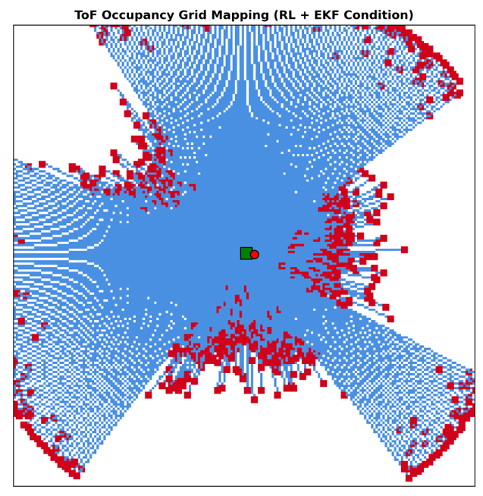
Qualitative Mapping Performance
EKF: Effective probabilistic filtering, but assumes fixed noise
RL + EKF: Adaptive noise tuning via learning
Results:
Reduced false positives (noise)
Smoother obstacle boundaries
Improved spatial consistency
Map Occupancy Grid Accuracy(Noise Reduction)
Obstacle detection Performance
Method | Accuracy
Raw | 58%
EKF | 72%
RL+EKF | 89%
Method | Precision | Recall
Raw | 0.62 | 0.70
EKF | 0.81 | 0.84
RL+EKF | 0.90 | 0.93

Slide 14
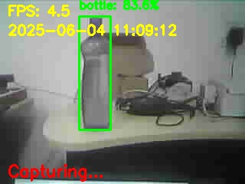
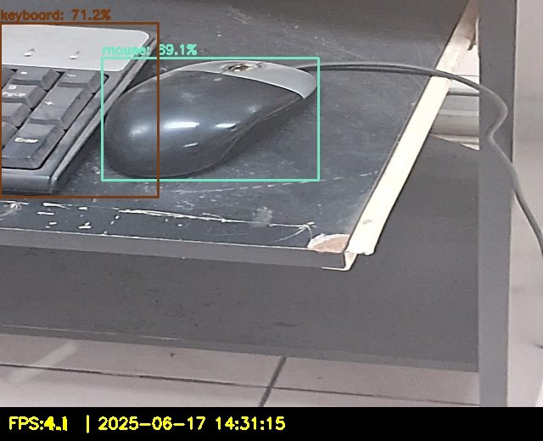
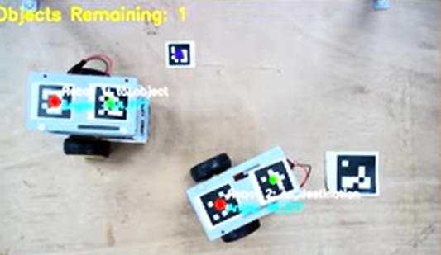
8. Conclusion:
Developed a hybrid RL + EKF + PID framework for low-cost swarm robots
Achieved significant improvement in localisation accuracy (~65–70% error reduction)
Enhanced mapping quality and robustness under noisy, uncertain environments
Demonstrated real-time, low-cost, scalable implementation
Future Scope
Decentralised swarm intelligence (fully distributed coordination)
Onboard RL deployment (edge AI on ESP32 S3)
Advanced learning models (Deep RL, belief-space planning)
Multi-modal sensor fusion (vision, LiDAR integration)
Real-time diagnostics & monitoring systems(Raspberry Pi 5 )

